Slide 1



Anammox
Anaerobic Ammonium Oxidation (Anammox) for Nitrogen Removal
Abdullah Matalgah
Mentor: Dr. Reyes Sierra
Dept. Chemical and Environmental Engineering
April, 14, 2018

Slide 2
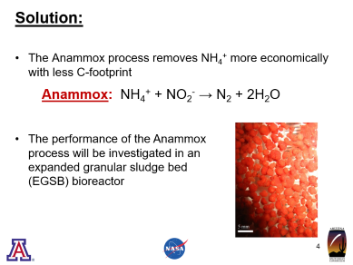
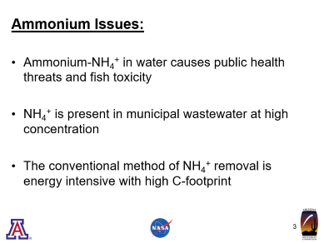
Our Objective is to Remove Ammonium

Slide 3
Ammonium Issues:
Ammonium-NH₄⁺ in water causes public health threats and fish toxicity
NH₄⁺ is present in municipal wastewater at high concentration
The conventional method of NH₄⁺ removal is energy intensive with high C-footprint

Slide 4
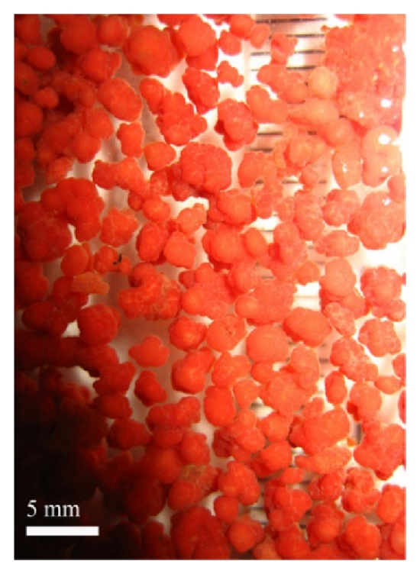
Solution:
The Anammox process removes NH₄⁺ more economically with less C-footprint
Anammox: NH₄⁺ + NO₂⁻ → N₂ + 2H₂O
The performance of the Anammox process will be investigated in an expanded granular sludge bed (EGSB) bioreactor

Slide 5
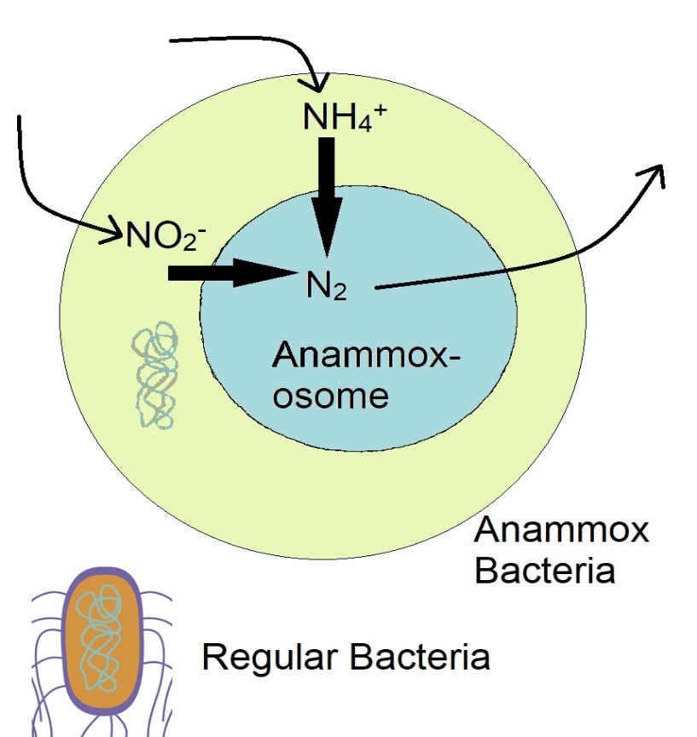
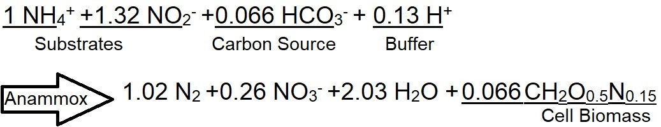
Mechanisms:
Double Time:
Anammox: 9-10 days
E-Coli: 20 minutes

Slide 6
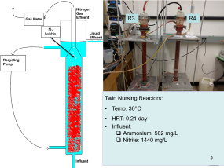
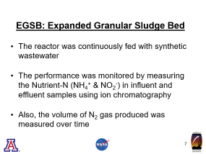
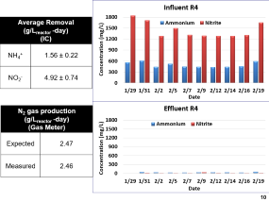
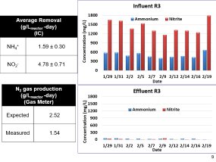
EGSB Bioreactor

Slide 7
EGSB: Expanded Granular Sludge Bed
The reactor was continuously fed with synthetic wastewater
The performance was monitored by measuring the Nutrient-N (NH₄⁺ & NO₂⁻) in influent and effluent samples using ion chromatography
Also, the volume of N₂ gas produced was measured over time

Slide 8
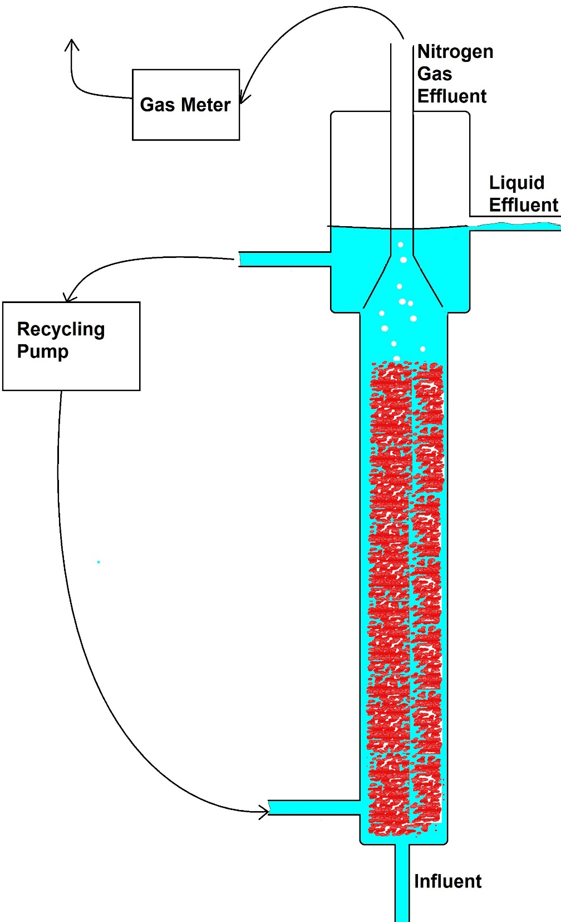
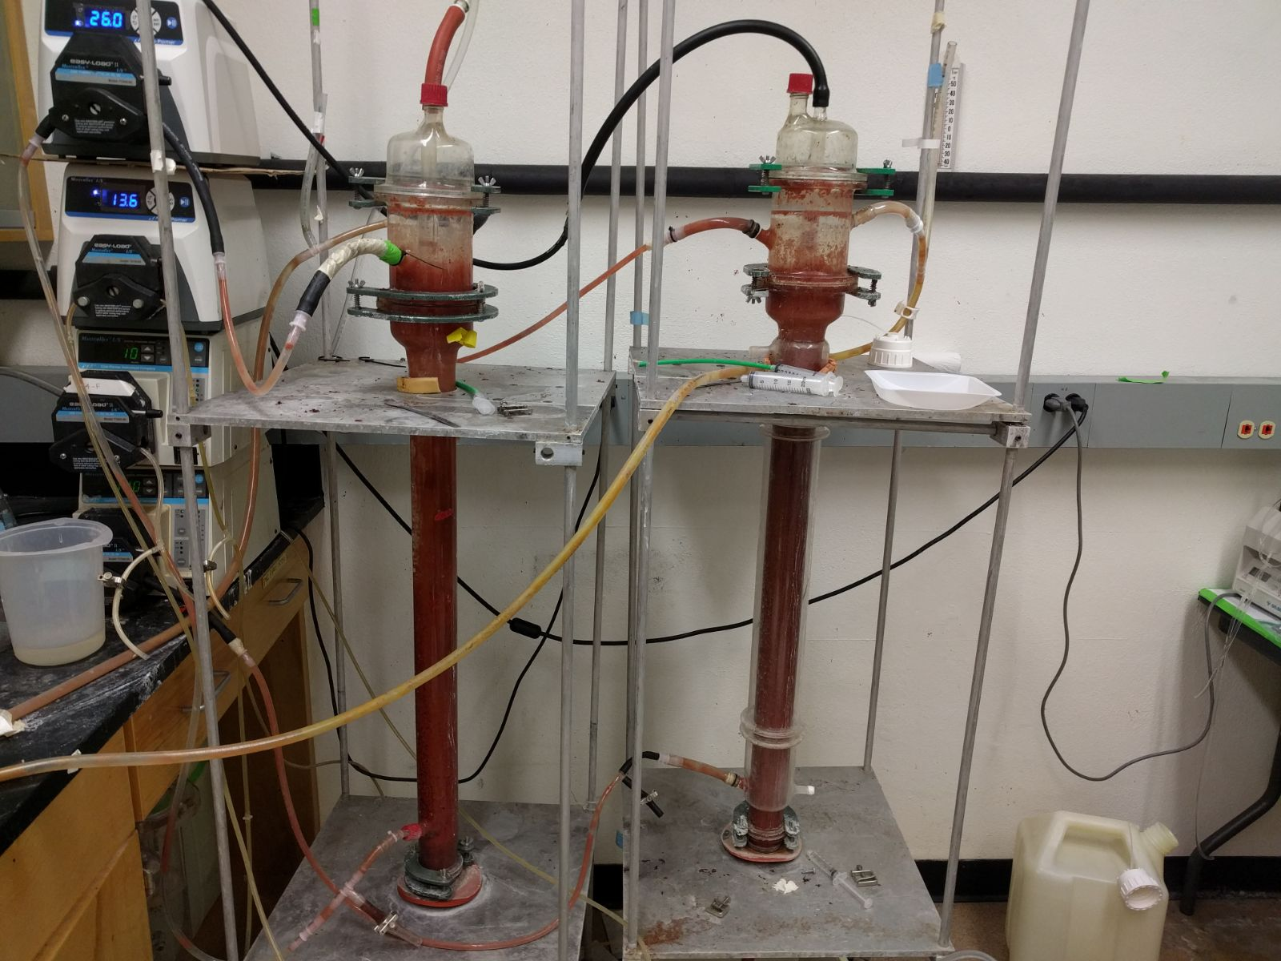
R3
R4
N₂ bubble
Twin Nursing Reactors:
Temp: 30°C
HRT: 0.21 day
Influent:
Ammonium: 502 mg/L
Nitrite: 1440 mg/L

Slide 9
Average Removal (g/L_{reactor} -day) (IC)
NH₄⁺ | 1.59 ± 0.30
NO₂⁻ | 4.78 ± 0.71
N₂ gas production (g/L_{reactor} -day) (Gas Meter)
Expected | 2.52
Measured | 1.54

Slide 10
Average Removal (g/L_{reactor} -day) (IC)
NH₄⁺ | 1.56 ± 0.22
NO₂⁻ | 4.92 ± 0.74
N₂ gas production (g/L_{reactor} -day) (Gas Meter)
Expected | 2.47
Measured | 2.46

Slide 11
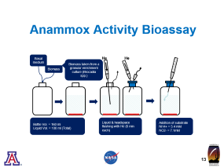
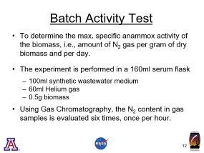
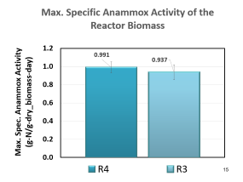
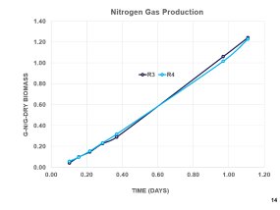
Anammox Activity Bioassay

Slide 12
Batch Activity Test
To determine the max. specific anammox activity of the biomass, i.e., amount of N₂ gas per gram of dry biomass and per day.
The experiment is performed in a 160ml serum flask
100ml synthetic wastewater medium
60ml Helium gas
0.5g biomass
Using Gas Chromatography, the N₂ content in gas samples is evaluated six times, once per hour.

Slide 13
Anammox Activity Bioassay
Basal medium
He
He
Biomass taken from a granular enrichment culture (Brocadia spp.)
Biomass
Bottle Vol. = 160 ml
Liquid Vol. = 100 ml (Total)
Liquid & headspace flushing with He (6 min each)
Addition of substrate
NH4+ = 5.4 mM
NO2- = 7.1mM

Slide 15


Slide 16
Conclusions
The continuous Anammox bioreactors provided high NH₄⁺ and NO₂⁻ removal efficiency (93% on average).
Based on the batch bioassays, the max. specific activity of the biomass was 1 g N/(gram dry biomass x day).
Due to the advantages of the Anammox Process, Pima County Water Reclamation Department is interested in implementing this process.

Slide 17
Acknowledgements
I would like to thank Dr. Reyes Sierra for introducing me to the water treatment field which made me more determinant of my future careers.
Special Thanks to Dr. Guangbin Li, Nivrutti Lakhey, Derek Swartzendruber, and Hezhou Ding for teaching and assisting me in the lab work.
Also, Thanks to NASA Space Grant for its support during this internship experience.

Slide 18


Slide 19
Appendices

Slide 20
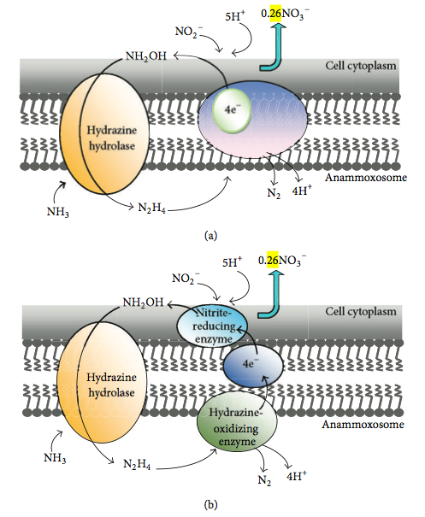
Mechanisms:
Influent: 1 NH₄⁺ +1.32 NO₂⁻ +0.066 HCO₃⁻ + 0.13 H⁺
Effluents: 1.02 N₂ +0.026 NO₃⁻ +2.03 H₂O +CH₂O_{0.5}N_{0.15}
https://en.wikipedia.org/wiki/Anammox

Slide 21
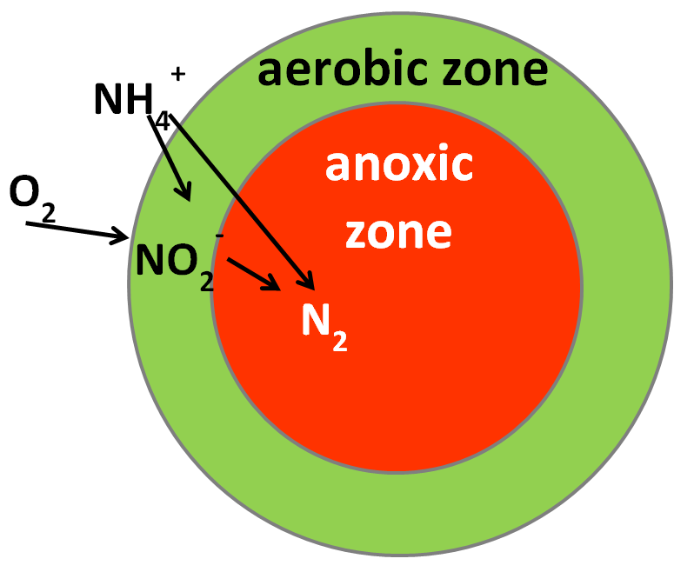
https://www.ugent.be/bw/biosysteemtechniek/en/research/biosystems-control/completed_research_projects/research-castrobarros.htm

Slide 22
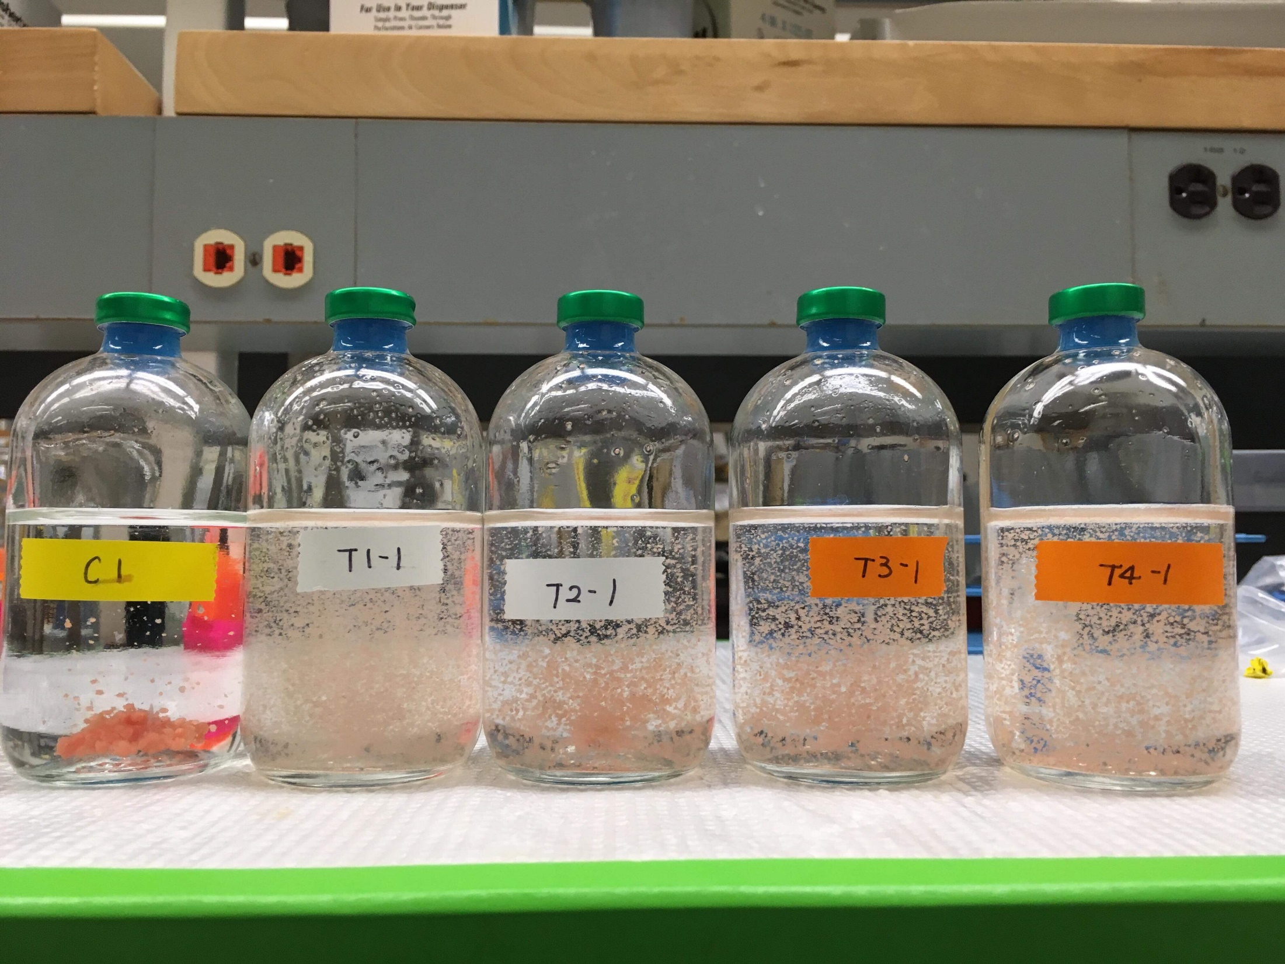
Sealing Cap
Serum flask
Anammox Bacteria
Medium
Helium gas

